Slide 1


LTE –EPC Fundamentals
Part-1
Mobile Comm Professionals,Inc

Slide 2
Module Objective
At the end of this session, you will be able to:
Describe LTE Key Principles & Network Identifiers
Describe LTE –EPS Architecture & its main Elements
Sketch the inter networking Architecture with 3G Networks
Sketch the LTE Air interface Channel Structure
Describe the Basic Technologies used in LTE

Slide 3
CONTENT
LTE Overview
LTE v/s Other Technologies
LTE Key Features
LTE Frequency Allocations & Network Identifiers
LTE-EPC Network Architecture & Procedure
LTE Air interface
LTE Technology Basics
MIMO Overview

Slide 4
Introduction to LTE

Slide 5

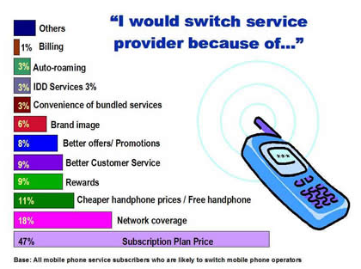
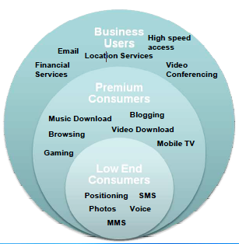
User Expectations
Highly desire of broadband acces everywhere
1. Home, Office
2. Train, Aeroplane, Canteen, during the Breake
Ubiquity (anywhere, anytime, wire free broadband)
Higher voice quality
Higher speed
Lower prices
Multitude of services

Slide 6


Operator Expectations
Higher data rates and reduced latency for multimedia rich applications (competitiveness of overall Customer proposition with rival technologies.
Architecture simplicity and reduced protocol complexity.
Seamless handover ensuring service continuity with legacy systems.
Reduced migration ,capital & operational costs, Investment protection by reusing existing assets.
Greater efficiency & flexibility.

Slide 7
HSPA Limitations
The maximum bit rates still are factor of 20 and more behind the current state of the art systems like 802.11n and 802.16e/m. Even the support for higher mobility levels is not an excuse for this.
The latency of user plane traffic (UMTS: >30ms) and of resource assignment procedures (UMTS: >100ms) is too big to handle traffic with high bit rate variance efficiently.
The terminal complexity for WCDMA or MC-CDMA systems is quite high, making equipment expensive, resulting in poor performing implementations of receivers and inhibiting the implementation of other performance enhancements.
Cell Breathing: The cell coverage shrinks as the loading increases
Notes:
Cell Breathing:-
In the uplink, as more and more UE are served by a cell, each UE needs to transmit higher power to compensate for the uplink noise rise. As a consequence, the UE with weaker link (UE at greater distance) may not have enough power to reach the NodeB therefore a coverage shrinkage.
In the downlink, the NodeB also needs to transmit higher power as more UE are being served. As a consequence UE with weaker link (greater distance) may not be reachable by the NodeB.

Slide 8
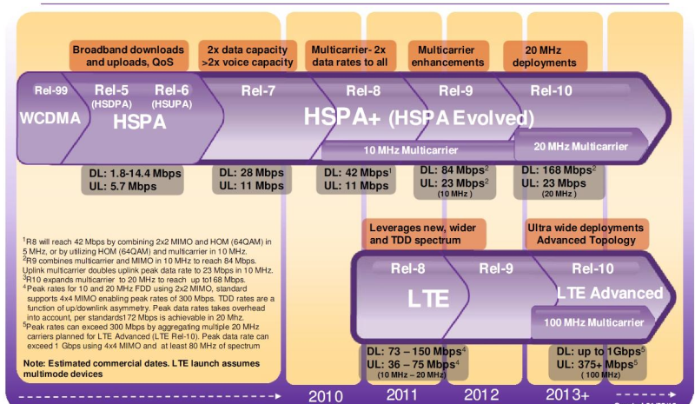
Parallel path of Evolution
Notes:
Release 99: Completed. First deployable version of UMTS. Enhancements to GSM data (EDGE). Majority of deployments today are based on Release 99. Provides support for GSM/EDGE/GPRS/WCDMA radio-access networks.
(After Release 99, release versions went to a numerical designation instead of designation by year.)
Release 4: Completed. Multimedia messaging support. First steps toward using IP transport in the core network.
Release 5: Completed. HSDPA. First phase of IMS. Full ability to use IP-based transport instead of just Asynchronous Transfer Mode (ATM) in the core network. In 2007, most UMTS deployments are based on this release.
Release 6: Completed. HSUPA. Enhanced multimedia support through Multimedia Broadcast/Multicast Services (MBMS). Performance specifications for advanced receivers. WLAN integration option. IMS enhancements. Initial VoIP capability.
Release 7: Completed. Provides enhanced GSM data functionality with Evolved EDGE. Specifies HSPA Evolution (HSPA+), which includes higher order modulation and MIMO. Also includes fine-tuning and incremental improvements of features from previous releases. Results include performance enhancements, improved spectral efficiency, increased capacity, and better resistance to interference. Continuous Packet Connectivity (CPC) enables efficient “always-on” service and enhanced uplink UL VoIP capacity as well as reductions in call setup delay for PoC. Radio enhancements include 64 QAM in the downlink DL and 16 QAM in the uplinks.
Release 8: Under development. Further HSPA Evolution features such as simultaneous use of MIMO and 64 QAM. Specifies OFDMA-based 3GPP LTE. Defines EPS, previously called System Architecture Evolution (SAE).Whereas operators and vendors actively involved in the development of wireless technology are heavily focused on 3GPP release versions, most users of the technology are more interested in particular features and capabilities, such as
whether a device supports HSDPA.

Slide 9
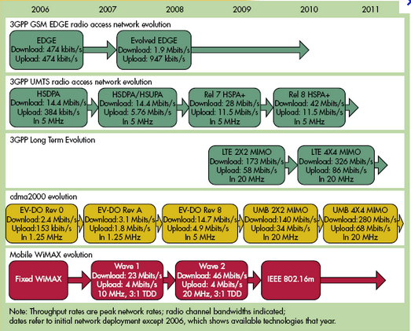

Evolution of LTE
It may look like alphabet soup, but the wireless industry is evolving toward faster rates, better ranges and more capacity through its ever changing standards
Notes:
The 3GPP Long Term Evolution (LTE) represents a major advance in cellular technology. LTE is designed to meet carrier needs for high-speed data and media transport as well as high-capacity voice support well into the next decade. LTE is well positioned to meet the requirements of next-generation mobile networks. It will enable operators to offer high performance, mass-market mobile broadband services, through a combination of high bit-rates and system throughput – in both the uplink and downlink – with low latency.
LTE infrastructure is designed to be as simple as possible to deploy and operate, through flexible technology that can be deployed in a wide variety of frequency bands. LTE offers scalable bandwidths, from less than 5MHz up to 20MHz, together with support for both FDD paired and TDD unpaired spectrum. The LTE–SAE architecture reduces the number of nodes, supports flexible network configurations and provides a high level of service availability. Furthermore, LTE–SAE will interoperate with GSM, WCDMA/HSPA, TD-SCDMA and CDMA.
LTE is the latest standard in the mobile network technology tree that previously realized the GSM/EDGE and UMTS/HSPA network technologies that now account for over 85% of all mobile subscribers. LTE will ensure 3GPP’s competitive edge over other cellular technologies.
Goals of LTE-
Significantly increase peak data rates, scaled linearly according to spectrum allocation.
improving spectral efficiency
lowering costs
improving services
making use of new spectrum opportunities
Improved quality of service
better integration with other open standards

Slide 10
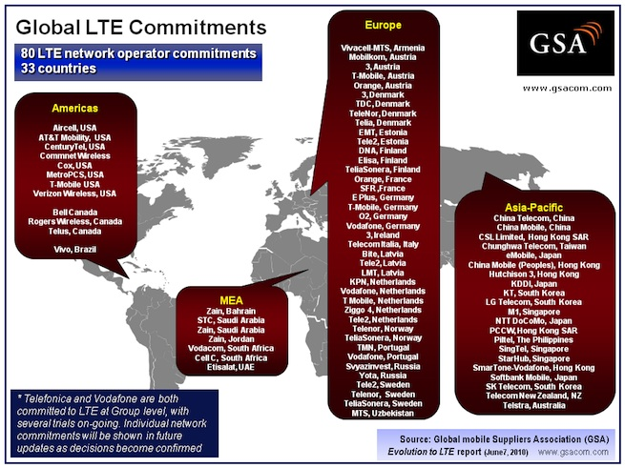
LTE Market Scenario
Notes:
The Global mobile Suppliers Association (GSA) has published an update to its Evolution to LTE report which confirms 110 operators in 48 countries are currently investing in LTE networks.
80 operators have made firm commitments to deploy LTE networks in 33 countries (compared to 64 network commitments identified two months ago). LTE networks are now being installed or planned for commercial service in Armenia, Australia, Austria, Bahrain, Brazil, Canada, China, Denmark, Estonia, Finland, France, Germany, Hong Kong SAR, Ireland, Italy, Japan, Jordan, Latvia, Netherlands, New Zealand, Norway, The Philippines, Portugal, Russia, Saudi Arabia, Singapore, South Africa, South Korea, Sweden, Taiwan, UAE, USA, and Uzbekistan.
GSA anticipates that up to 22 LTE networks will be in service by end 2010, and at least 45 are expected to be in service by end 2012. The first LTE networks entered commercial service in December 2009 in Norway and Sweden.

Slide 11
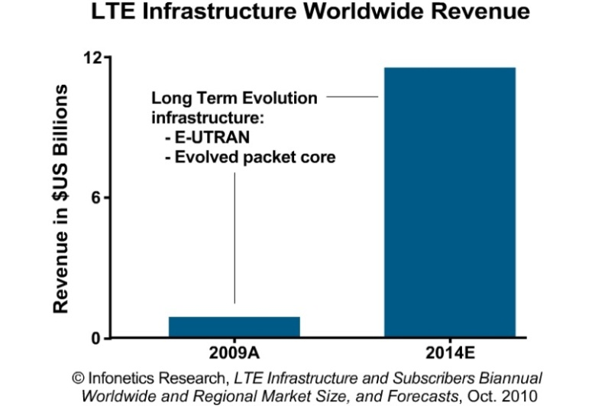
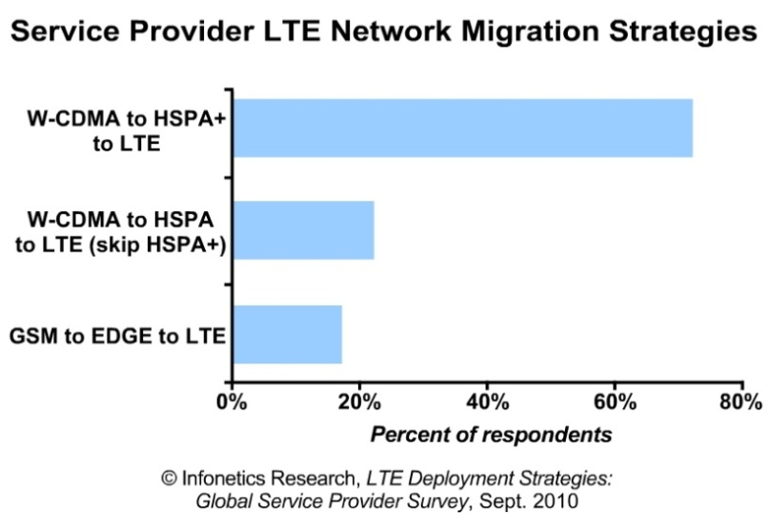
LTE Market Scenario
Evolution to LTE report, revealing that there are now 218 operators investing in LTE worldwide, with 91 commercial roll-outs expected by 2012. This number consists of 166 firm commercial deployments either in progress or planned across 62 countries and 52 operators in 19 countries that are engaged in trials.
Notes:
LTE revenues have reached over $ 2.1 Billion in 2011, up from $ 0.6 Billion in 2010
As of Q4'2011 the North America region accounts for over 42 % of the total LTE Infrastructure revenue
Ericsson and Alcatel Lucent are likely to lead the market with present market shares of over 35 % and 27 % respectively LTE infrastructure Industry respectively in 2011
From a regional perspective, the market share will drastically shift from a North American lead market to the Asia Pacific region, which will account for over 68 % of the revenue by 2015
Global 2G/3G/4G cellular network infrastructure revenues are set to reach over $ 51 Billion by 2015 up from $46 Billion in 2010 at a CAGR of 5%, with LTE accounting for more than 20 % of the revenue share

Slide 12
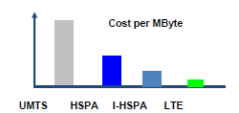
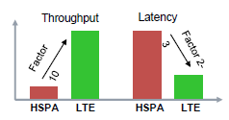
LTE brings significant benefits both for Operator and End user
Why LTE?
1.
Reduced complexity, flat IP based packet-only architecture lower TCO (CAPEX and OPEX).
Allow for introduction of cost efficient flat-rate pricing structures..
Inter-working with legacy systems as integral part of service continuity.
Scalable bandwidth allows flexible deployment with limited spectrum.
Significant improvements in spectral efficiency and data performance for multimedia services
Enriched user experience with real time, interactive services and seamless connectivity.
Wide area Broadband mobility up to high speeds.
Increased Throughput with decreased response times (DSL like behavior).
A wide variety of devices and services.

Slide 13
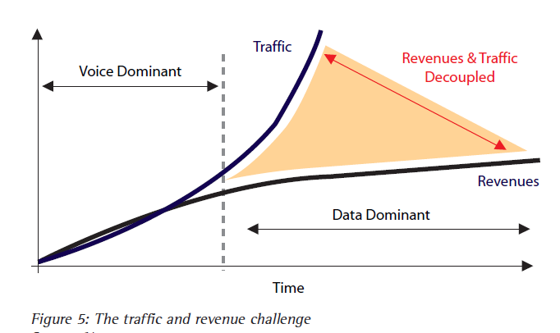
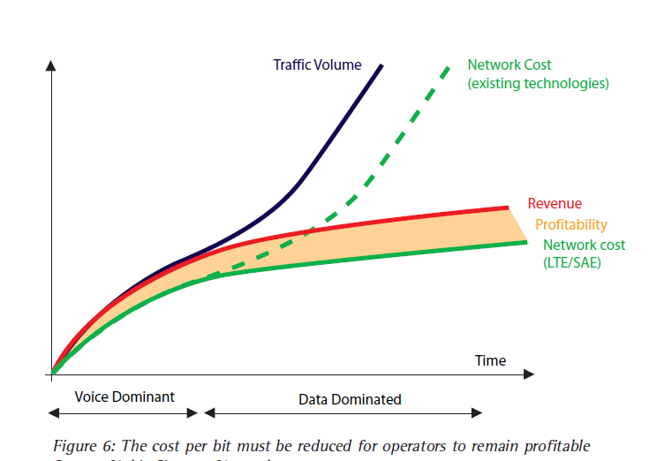
Why LTE?
2.
LTE Profitability
Notes:
Video consumes huge amounts of bandwidth. But consumer willingness to pay for a video service is not correlated with the bandwidth consumed by that service. In the data dominated world, unlike the voice dominated world, increased traffic does not result in proportionate increased revenue. In the data dominated world, the value to end-users of applications is not proportional to data volumes. Revenues and traffic have become decoupled. Many operators are experiencing a 10-fold increase in data traffic but more like a 10% increase in data revenue.
The success of mobile voice networks on a large scale does not automatically guarantee a similar victory for data services. Data and voice do not scale in the same way. Data is non-deterministic and uses a connectionless medium (IP) over which packets belonging to a single session can traverse several paths. Mobile data faces challenges of scale that need to be handled within the Radio Access Network (RAN) and the backhaul networks.
These are complex challenges. Meeting them by distribution of resources across the network alters the processing hierarchy and may compromise latency objectives. But effective scaling of services based on packet transport is essential as many events can create massive localized surges in demand.
Massive increases in data traffic can stress the existing radio access network and backhaul infrastructure. One suggested solution is to optimize the network to support the dominant traffic type, moving from voice-driven to data-driven Architectures.
Networks with greater capacity but lower costs per bit need to be deployed to handle the future demand for mobile broadband. The roadmap developed by 3GPP enables operators to do just that – irrespective of their legacy network infrastructure. 3G HSPA is the first step, followed by flat network architecture options such as 3G HSPA Evolution (HSPA+) and 3G Long Term Evolution (LTE) that promise even higher throughput.

Slide 14
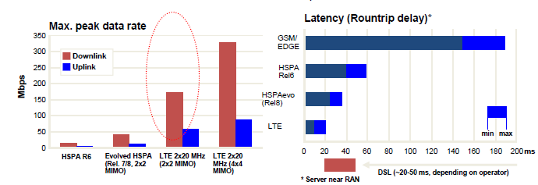
Why LTE?
3.
Throughput and Latency Evolution
Peak data rates around 300Mbps/80 Mbps Low latency 10-20 ms
Enhanced consumer experience:
drives subscriber uptake allow for new applications provide additional revenue streams
Notes:
Throughput-In communication networks, such as Ethernet or packet radio, throughput or network throughput is the average rate of successful message delivery over a communication channel. This data may be delivered over a physical or logical link, or pass through a certain network node. The throughput is usually measured in bits per second (bit/s or bps), and sometimes in data packets per second or data packets per time slot.
Latency-The time from the source sending a packet to the destination and processing the packet.

Slide 15
Comparison of LTE with Different Technologies

Slide 16
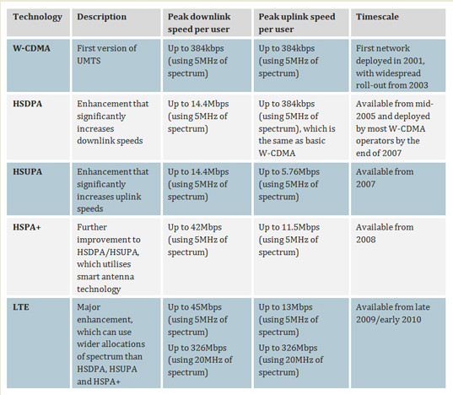
Comparison of LTE with 3G

Slide 17
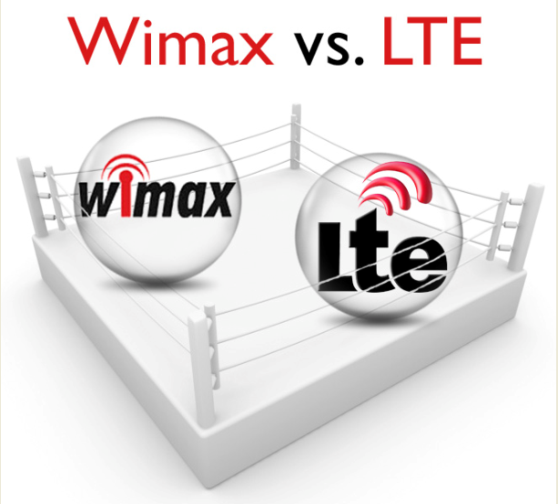

Slide 18
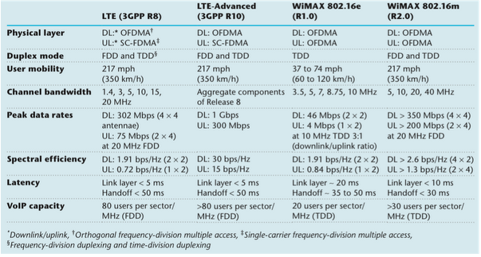
Comparison between LTE & WiMax
Notes:
After that Qualcomm, in November 2008, announced it was ending development of the Ultra Mobile Broadband (UMB) technology favoring LTE instead, LTE and WiMAX are the only two technologies that are competing to become the most widely adopted standard for 4G networks. WiMAX refers to the IEEE 802.16 family of standards which include notably IEEE 802.16-2004, the first major WiMAX standard for fixed access. This was superseded by IEEE 802.16e-2005, known as Mobile WiMAX, which provides both fixed and mobile access. In October 2009, the IEEE 802.16 Working Group submitted its proposal for IMT-Advanced based on IEEE 802.16m, which enhances IEEE 802.16e-2005 to meet the IMT-Advanced requirements. Although WiMAX benefits from its earlier development and deployment and today it has about 519 deployments worldwide with more than 10 million subscribers, LTE has quickly gained substantial momentum and it is expected to surpass WiMAX and become the accepted standard for 4G systems. This common thinking is supported by the Wireless Market Research and Analysis’ (Maravedis) forecasts which estimate 75 million WiMAX subscribers by 2014 while over 200 million LTE subscribers by 2015. It is also expected a migration of WiMAX operators towards LTE anytime before 2013. The aim of this post is to explain the reasons why LTE is going to win the “4G-battle”.
LTE vs WiMAX performance
Table shows the main technical specifications for WiMAX and LTE.
The performance of LTE (3GPP Release 8) and IEEE WiMAX 802.16m are similar in both data rates and latency, and mobility support. It is worth mentioning that both LTE and WiMAX use OFDMA in the downlink, but they differ in the uplink. WiMAX continues to use OFDMA, while LTE’s approach (SC-FDMA) is more advanced and allows a reduced peak-to-average ratio (PAPR) for the uplink signal. This makes it easier for the mobile terminal to maintain a highly efficient signal transmission using its power amplifier.
At the moment, 3GPP is working on LTE-Advanced (3GPP Release 2010) which promises further better performance and this is a clear advantage of 3GPP over WiMAX.

Slide 19
Comparison between LTE & WiMax
Notes:
Industry Support-The main difference between LTE and WiMAX is that they are supported by companies specialized in different fields. WiMAX supporters are mainly computer companies such as Intel and Cisco and there is a waning support from telecommunications companies. At the moment Sprint and Clear are the biggest service providers that have shown their commitment to WiMAX, while Samsung is the main smartphone manufacturer. On the other hand, as we saw in the previous paragraph, 3GPP counts more than 350 individual members, including major service providers, vendors, chipset providers, User Equipment (UE) providers, and test equipment vendors. Moreover, a strong confidence of service providers towards LTE arises from the close cooperation of 3GPP with NGMN alliance for defining the requirements of the standard and with LSTI for collaborative technology trials. As result of this cooperation, in July 2008, NGMN approved LTE as it first compliant technology, instead of WiMAX. Hence, since LTE was developed with support of the major mobile operators in the world, we can aspect that the great majority would adopt LTE, and not WiMAX.
Evolution from previous standards and interoperability-LTE comes form the 3GPP organization. An organization which has acquired broad confidence among users, vendors and service providers with GSM and UMTS. On the contrary, WiMAX comes from an industry association, which is quite new in the cellular networks. As a consequence, service providers and vendors are inclined to evolve their system from UMTS towards LTE instead of adopting a completely new standard. Moreover, LTE provides seamless integration with 3GPP-based 2G/3G networks and with 3GPP2-based 2G/3G networks and provides seamless handoff to CDMA/1xEV-DO. This interoperability capability of LTE with legacy systems is attractive to such providers as this will allow them to roll-out their LTE network in several phases without interrupting their existing services.
Smartphone manufacturers-Along with the mobile operators, also the smartphone and laptop manufacturers play an important role in the battle of 4G. Indeed, end-users will go for handsets with the coolest factor. The iPhone completely changed the way we look at mobile phones and what we expected from such devices, and it has contributed to increase exponentially the 3G data traffic generated by the mobile users. The continuing commitment of Apple in developing devices that only support 3GPP standards suggests that the successor of the iPhone 4 would probably support LTE standard. As Apple, other popular devices only support 3GPP standards, driving non-3GPP networks based service providers to converge to the 3GPP standards.
Result of the battle-From this analysis LTE has emerged as the favourite winner of the “4G-battle” and in the following years it will become the most widely adopted standard for 4G mobile communications. On the other hand, WiMAX will not disappear, indeed it has been targeting emerging markets that have little infrastructure, because WiMAX deployment would be faster and more cost-effective than laying a wired infrastructure. But we will see a migration of WiMAX operators towards LTE.

Slide 20
LTE Key Parameters

Slide 21
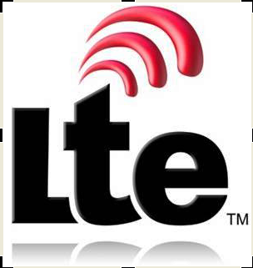
LTE Requirements and Performance Targets
High Peak Data Rates
100 Mbps DL (20 MHz, 2x2 MIMO)
50 Mbps UL (20 MHz, 1x2)
Improved Spectrum Efficiency
3-4x HSPA Rel’6 in DL*
2-3x HSPA Rel’6 in UL
1 bps/Hz broadcast
Improved Cell Edge Rates
2-3x HSPA Rel’6 in DL*
2-3x HSPA Rel’6 in UL
Full broadband coverage
Support Scalable BW
1.4, 3, 5, 10, 15, 20 MHz
Low Latency
< 5ms user plane (UE to RAN edge)
<100ms camped to active
< 50ms dormant to active
Packet Domain Only
High VoIP capacity
Simplified network architecture
Notes:
Discussion of the key requirements for the new LTE system led to the creation of a formal ‘Study Item’ in 3GPP with the specific aim of ‘evolving’ the 3GPP radio access technology to ensure competitiveness over a 10-year time-frame. Under the auspices of this Study Item, the requirements for LTE were refined and crystallized, being finalized in June 2005.
They can be summarized as follows:
• reduced delays, in terms of both connection establishment and transmission latency;
• increased user data rates;
• increased cell-edge bit-rate, for uniformity of service provision;
• reduced cost per bit, implying improved spectral efficiency;
• greater flexibility of spectrum usage, in both new and pre-existing bands;
• simplified network architecture;
• seamless mobility, including between different radio-access technologies;
• reasonable power consumption for the mobile terminal.

Slide 22
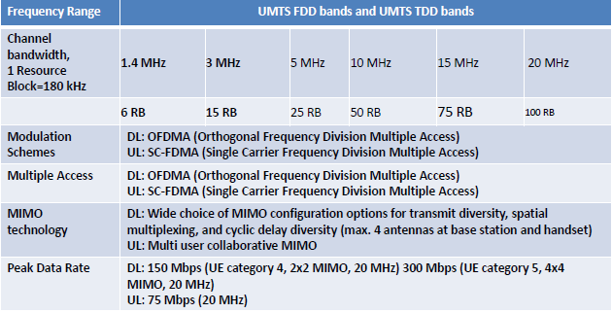

LTE Key Parameters

Slide 23
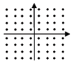
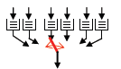
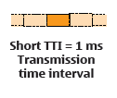
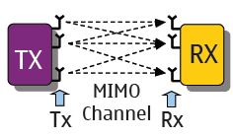
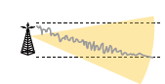
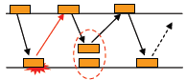
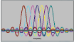
Key Principles of the LTE Air Interface
64 QAM
Advanced scheduling
Fast link Adaptation due to channel behavior
ARQ(Automatic repeat request)
Scalable
DL:OFDMA
UL:SC-FDMA
Notes:
1.64 QAM MODULATION-
OFDMA- (Orthogonal frequency division multiple access)used for downlink multiplexing.
Receiver complexity is at a reasonable level.
It supports various modulation schemes from BPSK,QPSK,16 QAM to 64 QAM.
SC-FDMA-(Single carrier frequency division multiple access) used for uplink multiplexing.
The Advantage against OFDMA to have a lower PAPR(Peak to average power ratio)meaning less power consumption and less expensive RF amplifiers in the terminal.
2.MIMO(Multiple input Multiple output)LTE will support MIMO as an option.
It describe the possibility to have multiple transmitter and receiver antennas in a system.
Up to 4 antennas can be used by a single LTE cell (Gain: spatial Multiplexing).
MIMO is considered to be the core technology to increase spectral efficiency.
3.HARQ (Hybrid automatic retransmission on request)this has been already used for HSDPA & HSUPA .
HARQ especially increases the performance delay and the performance(delay and throughput for cell edge users.
HARQ simply implements a retransmission protocol on layer1/layer2 that allows to send retransmitted blocks with different coding that the first one.
4.SCALABLE BANDWIDTH-LTE air interface allows to drive cells with 1.4 MHz,3 MHz,5 MHz,10 MHz,15 MHz & 20 MHz .This gives the required flexibility for operators to use spectrum allocations not available to a non-scalable wide band or ultra wide band system.

Slide 24
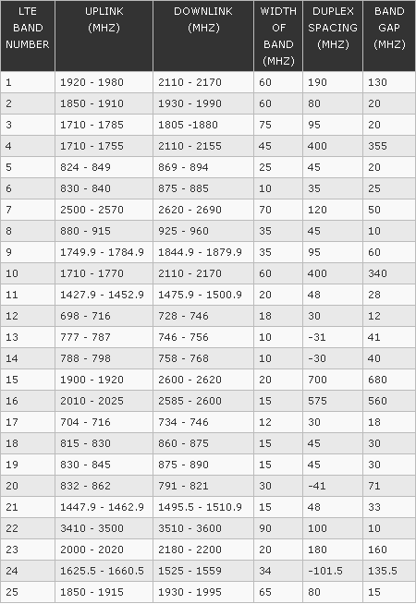
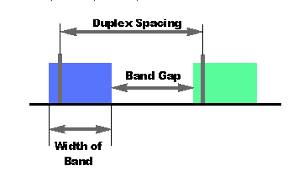
LTE Frequency Bands and Spectrum Allocations
FDD LTE frequency band Allocations
Notes:
There is a growing number of LTE frequency bands that are being designated as possibilities for use with LTE. Many of the LTE frequency bands are already in use for other cellular systems, whereas other LTE bands are new and being introduced as other users are re-allocated spectrum elsewhere. FDD and TDD LTE frequency bands-FDD spectrum requires pair bands, one of the uplink and one for the downlink, and TDD requires a single band as uplink and downlink are on the same frequency but time separated. As a result, there are different LTE band allocations for TDD and FDD. In some cases these bands may overlap, and it is therefore feasible, although unlikely that both TDD and FDD transmissions could be present on a particular LTE frequency band.
The greater likelihood is that a single UE or mobile will need to detect whether a TDD or FDD transmission should be made on a given band. UEs that roam may encounter both types on the same band. They will therefore need to detect what type of transmission is being made on that particular LTE band in its current location.
The different LTE frequency allocations or LTE frequency bands are allocated numbers. Currently the LTE bands between 1 & 22 are for paired spectrum, i.e. FDD, and LTE bands between 33 & 41 are for unpaired spectrum, i.e. TDD.
FDD LTE frequency band allocations-There is a large number of allocations or radio spectrum that has been reserved for FDD, frequency division duplex, LTE use.
The FDD LTE frequency bands are paired to allow simultaneous transmission on two frequencies. The bands also have a sufficient separation to enable the transmitted signals not to unduly impair the receiver performance. If the signals are too close then the receiver may be "blocked" and the sensitivity impaired. The separation must be sufficient to enable the roll-off of the antenna filtering to give sufficient attenuation of the transmitted signal within the receive band.
TDD LTE frequency band allocationsWith the interest in TDD LTE, there are several unpaired frequency allocations that are being prepared for LTE TDD use. The TDD LTE allocations are unpaired because the uplink and downlink share the same frequency, being time multiplexed. There are regular additions to the LTE frequency bands / LTE spectrum allocations as a result of negotiations at the ITU regulatory meetings. These LTE allocations are resulting in part from the digital dividend, and also from the pressure caused by the ever growing need for mobile communications. Many of the new LTE spectrum allocations are relatively small, often 10 - 20MHz in bandwidth, and this is a cause for concern. With LTE-Advanced needing bandwidths of 100 MHz, channel aggregation over a wide set of frequencies many be needed, and this has been recognized as a significant technological problem. . . . . . . . .

Slide 25
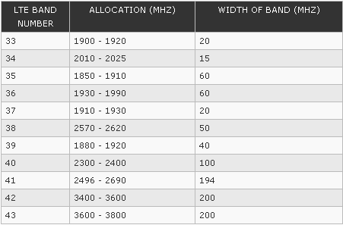
LTE Frequency Bands and Spectrum Allocations
TDD LTE frequency band Allocations
Notes:
Frequency bands may be allocated on a primary and secondary basis. Primary users have the first access to a band, in general. secondary users may use the band provided they do not cause interference to the primary users.
There are a few notes that can give some background to the LTE bands defined in the table on the previous page.
LTE Band 1: This is one of the paired bands that was defined for the 3G UTRA and 3GPP rel 99.
LTE Band 4: This LTE band was introduced as a new band for the Americas at the World (Administrative) Radio Conference, WRC-2000. This international conference is where international spectrum allocations are agreed. The downlink of band 4 overlaps with the downlink for Band 1. This facilitates roaming.
LTE Band 9: This band overlaps with Band 3 but has different band limits and it is also only intended for use in Japan. This enables roaming to be achieved more easily, and many terminals are defined such that that are dual band 3 + 9.
LTE Band 10: This band is an extension to Band 4 and may not be available everywhere. It provides an increase from 45 MHz bandwidth (paired) to 60 MHz paired.
LTE Band 11: This "1500 MHz" band is identified by 3GPP as a Japanese band, but it is allocated globally to the mobile service on a "co-primary basis".
LTE Band 12: This band was previously used for broadcasting and has been released as a result of the "Digital Dividend."
LTE Band 13: This band was previously used for broadcasting and has been released as a result of the "Digital Dividend." The duplex configuration is reversed from the standard, having the uplink higher in frequency than the downlink.
LTE Band 14: This band was previously used for broadcasting and has been released as a result of the "Digital Dividend." The duplex configuration is reversed from the standard, having the uplink higher in frequency than the downlink.
LTE Band 15: This LTE band has been defined by ETSI for use in Europe, but this has not been adopted by 3GPP. This band combines two nominally TDD bands to provide one FDD band.
LTE Band 16: This LTE band has been defined by ETSI for use in Europe, but this has not been adopted by 3GPP. This band combines two nominally TDD bands to provide one FDD band.
LTE Band 17: This band was previously used for broadcasting and has been released as a result of the "Digital Dividend."
LTE Band 20: The duplex configuration is reversed from the standard, having the uplink higher in frequency than the downlink.
LTE Band 21: This "1500 MHz" band is identified by 3GPP as a Japanese band, but it is allocated globally to the mobile service on a "co-primary basis".
LTE Band 24: The duplex configuration is reversed from the standard, having the uplink higher in frequency than the downlink.
LTE Band 33: This was one of the bands defined for unpaired spectrum in Rel 99 of the 3GPP specifications.
LTE Band 34: This was one of the bands defined for unpaired spectrum in Rel 99 of the 3GPP specifications.
LTE Band 38: This band is in the centre band spacing between the uplink and downlink pairs of LTE band 7.

Slide 26
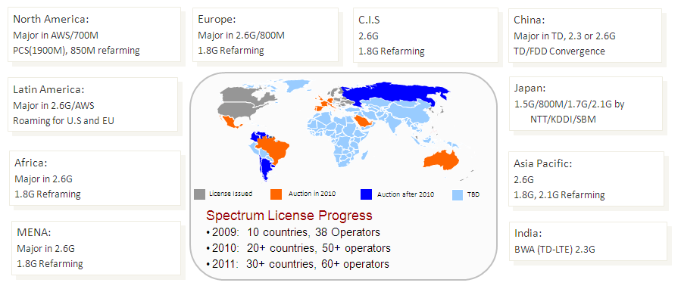
Available LTE Spectrum

Slide 27
Network Elements and the UE Identifiers
of LTE/SAE
Network
PLMN ID(MCC+MNC) 24 Bit
EPS Bearer ID
LTE/SAE ID’S
Networks Entities
MMEI=MMEGI +MMEC 16+8 Bit
GUMMEI=MCC+MNC+MMEI
Physical Cell ID 9 Bit
eNB/cell ID
TAI=MCC+MNC+TAC 32 Bit
Notes:
1. PLMN ID
Like in UTRAN multiple operators can share the same E-UTRAN. Consequently more than 1 PLMN ID (MCC + MNC) can be signaled.
2 .EPS Bearer ID
An EPS bearer ID uniquely identifies an EPS bearer for one UE accessing via EUTRAN.
3.MMEI
The MMEI provides a unique ID for identifying the MME during RRC connection establishment. It is constructed using the MMEGI identifying the group of MME’s and the MMEC being the code of the MME within these groups.
4. Physical Cell ID
This ID is related to the choice of the primary and secondary synchronization signals and scrambling codes of the cell.
5. eNB/cell ID
The exact definition of the eNB or cell ID is for further study at the point of time this training manual has been written. The eNB ID might be used in order to identify the old eNB after handover for better handover handling. The cell ID will also be used in the cell update procedure.
6. TAI
Each cell can be allocated only to one TAI – even though the TAI of different cells belonging to the same eNB can be different. The TAI is replacing both URA ID, LAI, and RAI. Similar as the LAI the TAI is constructed using MCC, MNC, and TAC.

Slide 28
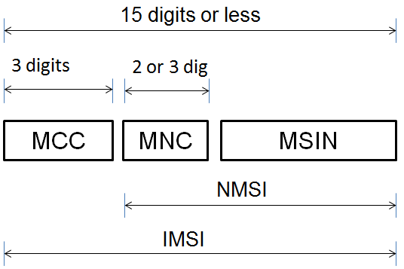
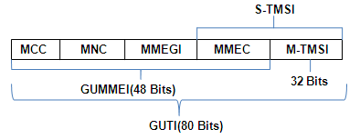
IMSI & GUTI Structure
1.Structure of IMSI
2.Structure of GUTI
Notes:
International Mobile Subscriber Identity (IMSI)
IMSI is used for subscriber identification and stored in the Subscriber Identity Module (SIM). IMSI is usually 15 digits long. The first 3 digits are the Mobile Country Code (MCC), and is followed by the Mobile Network Code (MNC), either 2 digits (European standard) or 3 digits (North American standard). The remaining digits are the mobile station identification number (MSIN) within the network's customer base.
Globally Unique Temporary UE Identity (GUTI ) The purpose of the GUTI is to provide an unambiguous identification of the UE that does not reveal the UE or the user's permanent identity in the Evolved Packet System (EPS). It also allows the identification of the MME and network. It can be used by network and the UE to establish UE's identity during signaling between them in EPS. On GUTI consist two main components: GUMMEI - that uniquely identifies the MME which has allocated the GUTI
M-TMSI - other that uniquely identifies the UE within the MME because of allocated the GUTI Because of that when UE is contacting the network it sends the GUTI to the eNodeB which then uses the GUTI number to identify to which MME re-establish request will be send. If the UE has moved from UMTS cell to LTE cell, a TAU procedure is made (because UE does not have its GUTI) and P-TMSI is send. By this way MME, which is in control of area to which UE moved to, can contact SGSN, which controlled area where UE was previously, to request the subscribers current profile like IP address and PDP contexts. Situation is similar when UE has moved from LTE to UMTS cell. GUTI is sent as the P-TMSI parameter and the procedure is referred as Routing Area Update (RAU).
If there is a situation where eNodeB from new LTE cell is not associated with MME on which GUMMEI is pointing eNodeB simply will select new MME. The new MME could get context information from old MME using same GUTI.
Temporary Mobile Subscriber Identity (S-TMSI)
For paging purposes, the mobile is paged with the S-TMSI. The S-TMSI is constructed from the MMEC and the M-TMSI. S-TMSI = MMEC + M-TMSI. It uniquely identity's the UE within an MME group. It is also included in RRC Connection Request.

Slide 29
Network Elements and the UE Identifiers
of LTE/SAE
E-UTRAN
C-RNTI 16 Bit
RA-RNTI 16Bit
SI-RNTI 16 Bit
P-RNTI 16 Bit
Random value 5 Bit
LTE/SAE ID’S
UE
IMSI 15 Bit
S-TMSI=MMEC+M-TMSI
IMEI 60 Bit
GUTI=GUMMI+M-TMSI
eNB S1-AP UE ID
MME S1 AP UE ID
Notes:
7. C-RNTI
The C-RNTI is identifying the RRC connection uniquely on cell level. It is replacing the H-RNTI for HSDPA and the E-RNTI for HSUPA. Each RRC connection is associated with C-RNTI.
8. RA-RNTI
The RA-RNTI is used during some transient states, the UE is temporarily identified with a random value for contention resolution purposes. The RA-RNTI is assigned by the eNB to a particular UE after this UE has sent a random access preamble on the Physical Access Channel (PRACH). If this random access preamble is received by the eNB and network granted, the base station sends an acquisition indication back to the mobile and this acquisition indication message contains the RA-RNTI. In turn the UE will use the RA-RNTI to send RRC connection request message on the radio interface UL and the parameter will help to distinguish messages sent by different UEs on the Random Access Channel (RACH). This procedure is called as contention based random access procedure.
9. SI-RNTI
The SI-RNTI is used in order to identity paging groups on the BCCH mapped on the DL-SCH. The SI-RNTI is sent on the PDCCH. It does not stand for a particular UE identity. Instead it signals to all mobiles in a cell where the broadcast System Information Blocks (SIBs) are found on the Physical Downlink Shared Channel (PDSCH). This is necessary since the PDSCH is used to transport both broadcast system information for all UEs and signaling/payload for particular mobiles. In other words, the SI-RNTI indicated which DL resource blocks are used to carry SIBs.
10. P-RNTI
The P-RNTI is used in order to identity paging groups on the PCH mapped on the PDSCH. The P-RNTI is derived from the IMSI of the subscribed to be paged and constructed by the eNB. For this reason IMSI is transmitted in a S1AP paging message from the MME to eNB. To receive paging messages from E-UTRAN, UEs in idle mode monitor the PDCCH channel for P-RNTI value used to indicate paging.
11.Temporary Cell RNTI (TC-RNTI)
When the UE does not have allocated C-RNTI then Temporary C-RNTI is used. A temporary identity, the TC-RNTI, used for further communication between the terminal and the network. If the communication is successful then TC-RNTI is promoted eventually to C-RNTI in the case of UE not having a C-RNTI.
12. Random Value
During random access the UE is using a random ID for contention resolution.
13.eNB S1-AP UE ID and MME S1-AP UE ID
The eNB S1-AP UE ID and MME S1-AP UE ID are temporary ID’s which are identifying the UE in the S1-MME in the eNB or MME respectively.

Slide 30
LTE-SAE Architecture

Slide 31
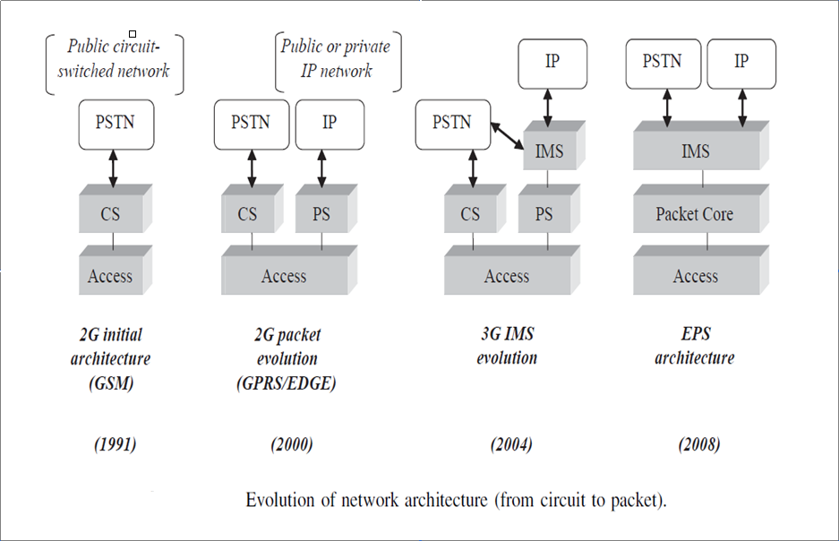
SAE: SYSTEM ARCHITECTURE EVOLUTION
Notes:
In order to understand the major trends of evolved 3G architecture, it is necessary to look at the main steps of wireless network evolution, starting with 2G networks.
2G Initial Architecture
2G GSM cellular networks were initially designed for voice and circuit-switched services. For that reason, the architecture of such networks was comparatively simple and comprises two main parts:
. The Access Network part, which includes the radio interface as well as the network nodes and interfaces supporting radio-related functions. In initial 2G GSM systems, the radio interface was specifically designed and optimized for voice or low bit rate circuit data transmission.
. The CS part – or circuit-switched core network domain providing circuit services support (this includes call setup, authentication and billing) and inter-working with classical PSTN (Public Switched Telephone Network).
2G Packet Evolution
With the emergence of IP and Web services, 2G GSM networks eventually evolved to efficiently support packet data transmission:
. The Access Network part was partly redesigned to support packet transmission and shared resource allocation schemes – as for GPRS and EDGE evolutions.
. A new Core Network domain (PS for Packet Switched) was added, in parallel to the CS domain. This new domain has the same role as the CS domain, meaning support for packet transmission (including authentication and billing) as well as inter-working with public or private Internet (or IP) networks.
The CS domain is composed of a MSC/VLR (Mobile Switching Center/Visitor Location Register) responsible for end-to-end call setup and in charge of maintaining user location information (such information is typically used to page a user terminal in order to establish user-terminated communication sessions). The GMSC (Gateway MSC) is a specific type of MSC, as being the gateway switch responsible for PSTN inter-working.
The PS domain is composed of the SGSN (Serving GPRS Support Node), which basically plays the role of a MSC/VLR for the packet domain, and the GGSN (Gateway GPRS Support Node), which is equivalent to the GMSC for inter-working with external packet networks.
PS and CS domains may possibly be linked together in order to maintain consistent user location information between the two domains and therefore reduce the amount of radio and network signaling.
In addition to the domain-specific nodes, the Core Network also contains the HLR (Home Location Register), accessed by both the CS and PS domains. The HLR is a key part of the network architecture, containing all information related to user subscription

Slide 32
SAE: SYSTEM ARCHITECTURE EVOLUTION
Notes:
3G IMS Evolution
From a system overview, initial 3G UMTS network architecture was more or less the same as the 2G, as it included both circuit and packet Core Networks. Eventually, a new domain was added on top of the PS domain: the IMS (IP Multimedia Subsystem).The main objective of IMS was to allow the creation of standard and interoperable IP services (like .Push-To-Talk., .Presence. or .Instant Messaging.) in a consistent way across 3GPP wireless networks. The interoperability of IMS-based services comes from the fact that IMS is based on flexible protocols like SIP (Session Initiation Protocol) developed by the
IETF (Internet Engineering Task Force – an international community dedicated to the evolution of the Internet).
In addition, the IMS standard offers VoIP (Voice over IP) support and provides interworking with classical PSTN through signaling and media gateways.
Although IMS was presented as an interesting step towards service integration, legacy network operators refrained from widely deploying and using it as a common platform for all services (including voice, real-time and non real-time services) because of the lack of support for voice services. seamless mobility between existing CS-based networks and IMS
EPS Architecture
Evolved UMTS networks have a clear objective to integrate all applications over a simplified and common architecture. The main components of EPS architecture are the following:
. A packet-optimized Access Network which can efficiently support IP-based non real-time services as well as circuit-like services requiring constant delay and constant bit rate transmission.
. A simplified Core Network, composed of only one packet domain, supporting all PS services (possibly IMS-based) and inter-working capabilities towards traditional PSTN.
The CS domain is no longer present, as all applications (including the most real-time constraining ones) are supported over the PS domain. This obviously requires specific gateway nodes – part of the IMS architecture – so that IP traffic is converted to PSTN circuit-switched-based transport

Slide 33
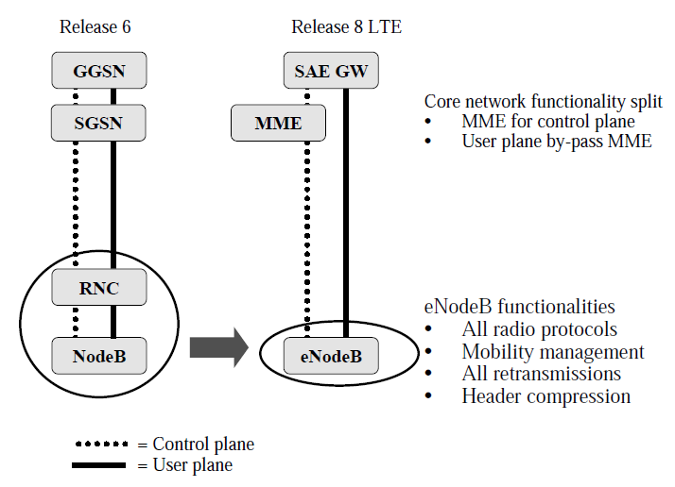
LTE System Architecture Evolution
Notes:
The high network capacity also requires an efficient network architecture in addition to the advanced radio features. The target in 3GPP Release 8 is to improve the network scalability for traffic increase and to minimize the end-to-end latency by reducing the number of network elements. All radio protocols, mobility management, header compression and all packet retransmissions are located in the base stations called eNodeB. eNodeB includes all those algorithms that are located in Radio Network Controller (RNC) in 3GPP Release 6 architecture. Also the core network is streamlined by separating the user and the control planes. The Mobility Management Entity (MME) is just the control plane element while the user plane bypasses MME directly to System Architecture Evolution (SAE) Gateway (GW).
The LTE architecture consists of E-UTRAN (Evolved UMTS Terrestrial Radio Access Network) on the access side and EPC (Evolved Packet Core) on the core side.
A typical LTE/SAE network will have two types of network elements.
The first is the new enhanced base station, so called “Evolved NodeB (eNodeB)” per 3GPP standards. This enhanced BTS provides the LTE air interface and performs radio resource management for the evolved access system.
The second is the new Access Gateway (AGW). The AGW provides termination of the LTE bearer. It also acts as a mobility anchor point for the user plane. It implements key logical functions including MME (Mobility Management Entity) for the Control Plane and for the User Plane. These functions may be split into separate physical nodes, depending on the vendor-specific implementation.

Slide 34
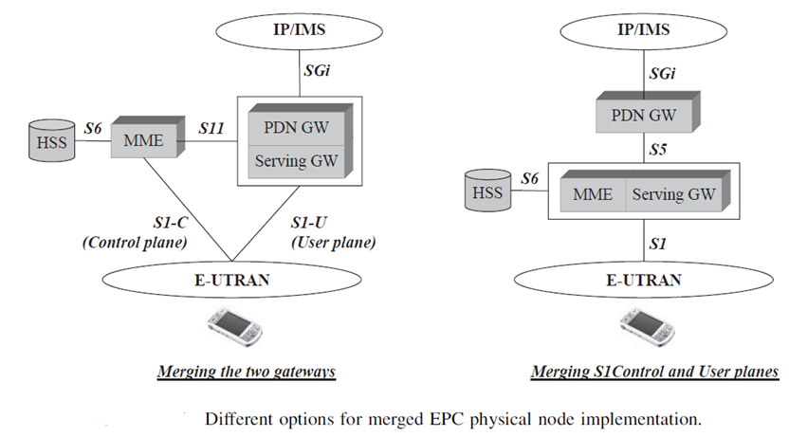
LTE System Architecture Evolution
Notes:
This model shows the interface S1 which transports both signalling (the S1-C part) and User
plane data (the S1-U part) between E-UTRAN and EPC as well as interface SGi – the
equivalent of the 2G and 3G Packet Core Gi – towards public or private external IP networks,
or the IMS domain.
The right-hand option of the picture (with combined MME and Serving Gateway) may be
seen as a simpler solution to operate a Packet Core network, since it does not require
implementing and operating the S11 signalling interface between the MME and Serving GW.
However, implementing separated MME and User plane functions allows further flexibility in
terms of deployment, allowing independent scalability between the signalling load on the
Control plane and traffic handling on the User plane.
In any kind of implementation, the S5 interface has been defined in such a way as to allow
connectivity to multiple Packet Data Networks, providing the same flexibility as the Gn
interface defined between SGSN and GGSN 2G/3G nodes – the S5 interface is actually an
evolved version of the Gn interface based on the GTP (GPRS Tunnelling Protocol). The
typical use case of such a configuration would be, for example, to separate the access to an
Intranet from the public IP network access, In this case, access to each of the
networks is done through a specific PDN GW, which allows implementing specific policy enforcement rules, or packet-filtering algorithms, depending on the type of packet network
being addressed.
From a functional perspective, the association of MME and Serving GW features is
actually very close to a combination of 2G/3G SGSN. Similarly, the PDN GW logical node
can also be considered as a kind of 2G/3G GGSN, in its role to support policy-enforcement
and charging rules, inter-working with external packet networks, as well as terminal IP
address allocation.

Slide 35
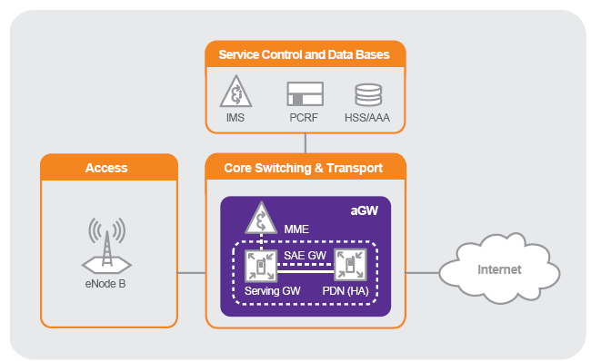
Evolved Packet System (EPS) Architecture – Subsystems
Notes:
The LTE/EPC architecture is driven by the goal to optimize the system for packet data transfer.
Tip
There are no circuit switched components in LTE/EPC
There is a new approach in the inter-connection between radio access network and core network. The EPS architecture is made up of an EPC (Packet Core Network, also referred as EPC) and an eUTRAN Radio Access Network (also referred as LTE)
The CN provides access to external packet IP networks and performs a number of CN related functions (e.g. QoS, security, mobility and terminal context management) for idle (camped) and active terminals. The RAN performs all radio interface related functions.
The LTE/EPC radio access network - Evolved UTRAN (E-UTRAN) - will only contain Node Bs. No RNC is provided anymore. This means, that the evolved Node Bs take over the radio management functionality.
This will make radio management faster and the network architecture simpler. E-UTRAN exclusively uses IP as transport layer. Behind the EPC follow one or more IP networks. A major example will be IMS, that can benefit especially from the QoS awareness of LTE.

Slide 36
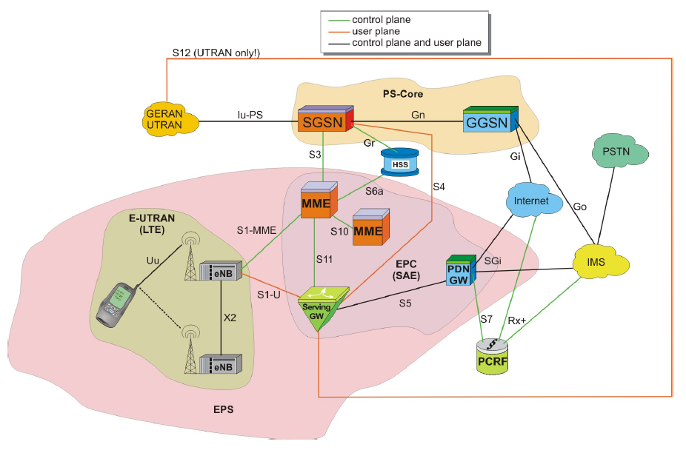
LTE –SAE Architecture
Notes:
Reason for SAE System Architecture Evolution
The SAE System Architecture Evolution offers many advantages over previous topologies and systems used for cellular core networks. As a result it is anticipated that it will be wide adopted by the cellular operators.
SAE System Architecture Evolution will offer a number of key advantages:
Improved data capacity: With 3G LTE offering data download rates of 100 Mbps, and the focus of the system being on mobile broadband, it will be necessary for the network to be able to handle much greater levels of data. To achieve this it is necessary to adopt a system architecture that lends itself to much grater levels of data transfer.
All IP architecture: When 3G was first developed, voice was still carried as circuit switched data. Since then there has been a relentless move to IP data. Accordingly the new SAE, System Architecture Evolution schemes have adopted an all IP network configuration.
Reduced latency: With increased levels of interaction being required and much faster responses, the new SAE concepts have been evolved to ensure that the levels of latency have been reduced to around 10 ms. This will ensure that applications using 3G LTE will be sufficiently responsive.
Reduced OPEX and CAPEX: A key element for any operator is to reduce costs. It is therefore essential that any new design reduces both the capital expenditure (CAPEX)and the operational expenditure (OPEX). The new flat architecture used for SAE System Architecture Evolution means that only two node types are used. In addition to this a high level of automatic configuration is introduced and this reduces the set-up and commissioning time.

Slide 37



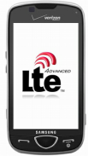

Evolved Node B
S1-MME
Selection of MME at attachment
Scheduling of paging messages
Uu
Routing of User plane to Serving GW
S1-U
PDCP
IP Header Compression
Encryption
RRM/RRC
Radio Bearer/Admission control
Mobility Management
Measurement Management
Inter Cell RRM
QOS control
RLC
Configurable Reliability
Variable RLC-PDU Length
TM,AM,UM
MAC
Dynamic Scheduling (UL/DL)on shared channels (according to QOS)
Scheduling of Broadcast Information(MME & O&M generated )
Notes:
Functions of eNB-
Selection of MME at attachment
Since there is the S1-flex feature more than one MME can be connected to the same eNB. The eNB select which MME it connects the UE to according to the load situation and the operator the UE belongs to.
Scheduling of paging messages
Once the UE is in the idle state there are neither location areas nor routing areas but tracking areas. Then the UE needs to be paged on TA level. The TA is having a function like the URA but is also replacing LA and RA.
Routing of user plane data to Serving GW
It is for further study which node is establishing the user plane tunnel and whether it is established at RRC establishment.
PDCP
Please note here that PDCP is used for both control and user plane. In UTRAN there is no PDCP in the control plane.
RRM/RRC
The RRC is issuing commands executing the decisions of the RRM.
RLC
Since L1 RLC and MAC are in the eNB there is the possibility to adapt the RLC-PDU size flexibly to the transport block size in MAC.
MAC
A Scheduling with support for QOS provides for efficient scheduling of User plane and control plane data.

Slide 38

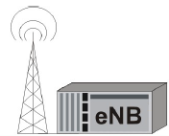


Mobility Management Entity
NAS Signaling
SAE Bearer Management
-QOS control
Generation of Paging Messages
Idle state mobility Management
UE tracking and reachability
S1-MME
S10
Inter CN node Signaling
Selection of Serving GW,PDN GW and MME/SGSN(Handover)
Roaming
S11
S6a
Security Management
Authentication
Ciphering and Integrity Protection
of NAS Signaling.
S3
Notes:
Functions of MME-
NAS signaling
Once the UE is idle but stays registered the MME keeps the context of the UE in order to allow for a fast reconnection.
Inter CN node signaling (3GPP networks)
The MME is interconnecting to the SGSN and the HSS as well as to the Serving GW and it has the responsibility to select the right code network nodes – especially in a handover situation.
Security management
The MME implements functions for authentication,autherization and accounting (AAA) to verify user’s identites,grant access to the network and track User’s activities ,respectively .In addition ,the MME performs ciphering and integrity protection of NAS message Signaling.

Slide 39


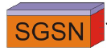


Serving Gateway
S11
Termination of U- plane packets for Paging reasons.
Support of UE Mobility Anchoring by Switching U-plane during inter eNB Handover.
S-1U
Transport level packet Marking according to QCI
S5
Mobility Anchoring for inter 3GPP Mobility
S4
Packet Routing and Forwarding
Charging Support
Lawful Interception
Notes:
Functions of Serving Gateway-
Termination of U-plane packets for paging reasons
Once data is arriving in the downlink and the UE is in EMM-REGISTERED & ECM IDLE then the Serving Gateway is initiating the paging procedure before forwarding the data packets further.
Support of UE mobility anchoring by switching U-plane during inter eNB handover
At any time each UE has just one Serving GW. Once the UE does not leave the zone of the Serving GW the Serving GW stays the same (anchoring).
Transport Packet Marking According to QCI
The marking of the packets is helping the eNB to reinforce the right QoS.
Mobility anchoring for inter-3GPP mobility
It terminates the S4 interface towards the SGSN for 2G/3G traffic.
Packet routing and forwarding
In handover situations involving different code network entities the packets need to be forward to the target Serving GW before the handover is complete.
Charging support
Lawful interception
The Serving GW has to support tapping the user plane for lawful interception purposes.

Slide 40

Packet Data Network Gateway
SGi
Termination towards PDN’s
Lawful Interception
Packet Filtering
-deep Packet inspection per user
Transport level Packet Marking according to QCI
DL rate Enforcement
S5
PDN
Policy Enforcement
Charging Support
DHCPV4 and DHCPV6 Functions
Notes:
PDN GW’s difference to the Serving GW is that this PDN GW is directed towards the PDN, IMS, PSTN and service related core network entities, whereas the Serving GW has a clear direction towards the E-UTRAN.
Functions of PDN Gateway-
Termination towards of PDN’s
If the UE using more than one PDN it may use more than one PDN GW. Once the UE connects to a PDN GW for a service then it stays connected to this PDN GW as long as the service is consumed.
Policy enforcement
Charging support
For users visiting the network the charging policies may be downloaded from its home PLMN.
DHCPv4 and DHCPv6 functions
The PDN GW will provide the IP addresses to the UE’s.
-

Slide 41
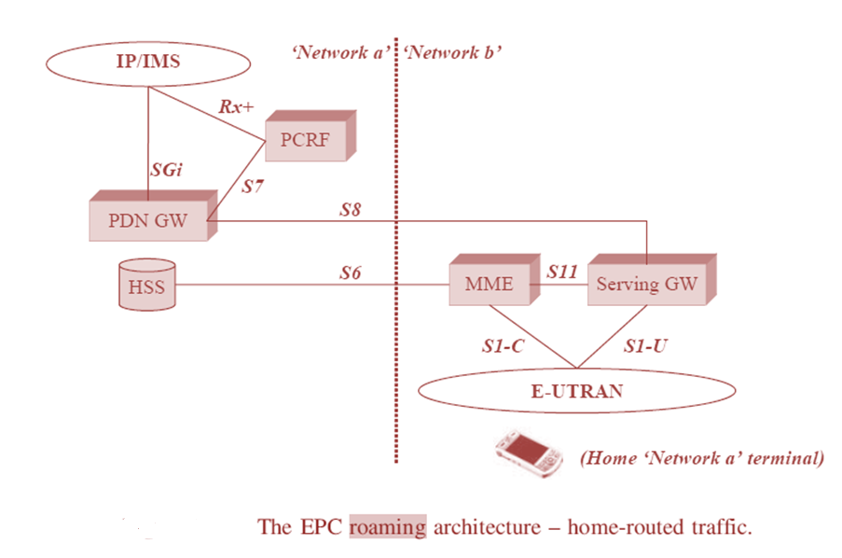
Roaming architecture: Two different scenarios
Notes:
The visited network provides the access connectivity (which also
involves the basic session signalling procedures supported by the visited MME, with the
support of the home HSS), whereas the home network still provides the access to external
networks, possibly including IMS-based services.
In this model, the call is still anchored to the home PDNGW, hence the .home routed traffic denomination.

Slide 42
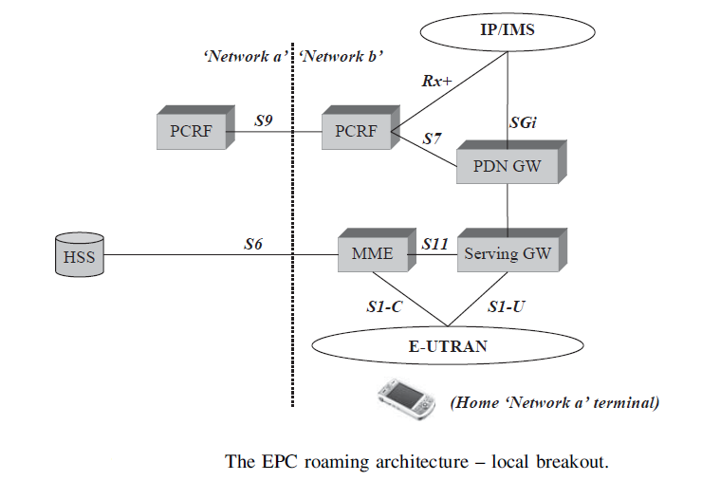
Roaming architecture: Two different scenarios
Notes:
This Figure describes possible network architecture in the case where the traffic is routed
locally – or the local breakout case. Both Gateways are part of the visited network. The
visited PCRF retrieves Quality of Service policy and charging control information from the
Home PCRF via the new S9 interface

Slide 43
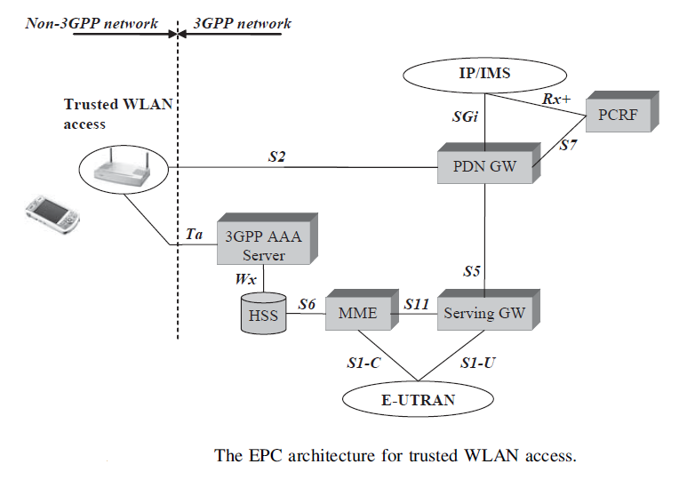
Non 3GPP Trusted Network
Notes:
The 3GPPAAA Server’s role is to act as an inter-working unit between the 3GPP world and IETF standard-driven WLAN networks from the security perspective. Its purpose is to allow end-to-end authentication with WLAN terminals using 3GPP credentials. For that reason, the 3GPPAAA Server has an access to the HSS through the Wx interface, so as to retrieve user related subscription information and 3GPP authentication vectors.
From the 3GPP AAA Server, the Ta interface has been defined with the trusted access network, aiming at transporting authentication, authorization and charging-related information in a secure manner.

Slide 44
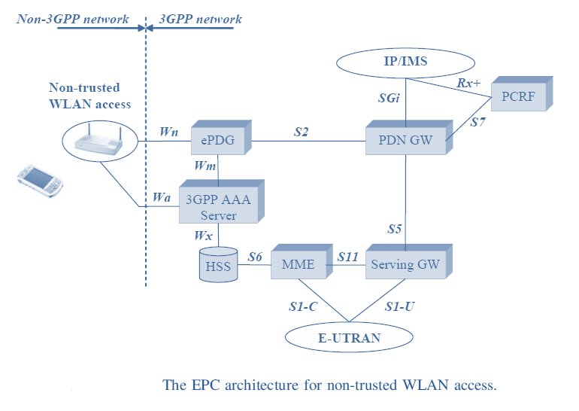
Non 3GPP non-trusted Network
Notes:
In this model, the new Wm interface is introduced for the purpose of exchanging user related information from the 3GPP AAA Server to the ePDG. This will allow the ePDG to enable proper user data tunnelling and encryption to the terminal.

Slide 45
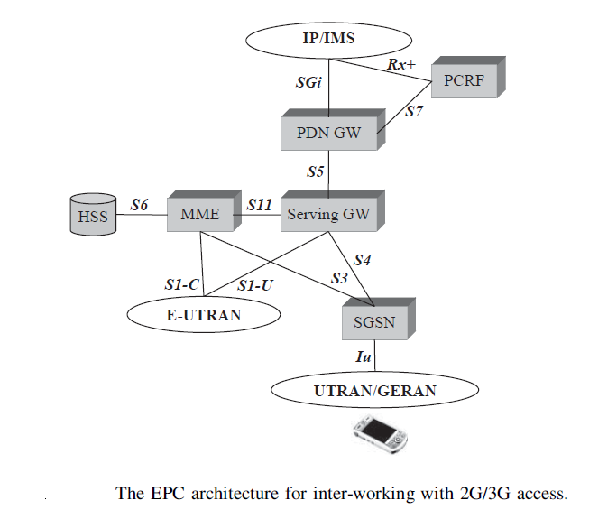
LTE/EPS inter-working with 2G/3G networks
Notes:
The 2G/GSM access network, as in 3GPP terminology.
The 2G/3G mobility architecture model introduces two interfaces: S3 and S4.
The role of S3 is to support user and bearer information exchange between the SGSN and the MME, as the terminal is moving from one access type to the other.
The S4 interface is associated with the session User plane. It supports packet data transfer between the SGSN and the Serving GW .which plays the role of a mobility anchor point within the EPC architecture

Slide 46
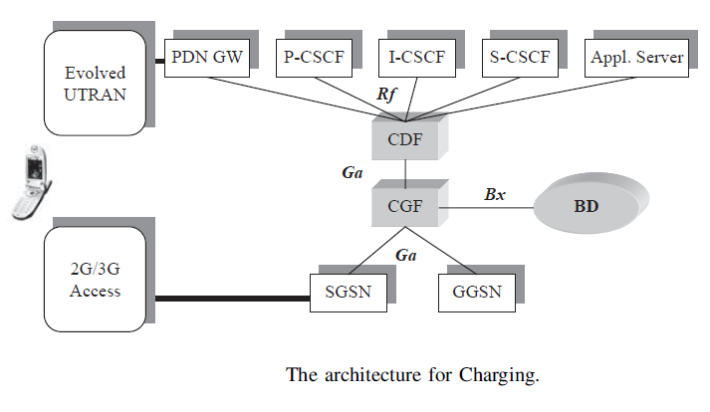
Charging Architecture in LTE/EPS networks
Notes:
Figure presents the network elements involved in the charging process and their interaction with 2G, 3G and IMS network nodes. The role of the CDF (Charging Data Function) is to collect charging information from the different nodes through the RF interface and build the corresponding CDR. The type of nodes being linked to the CDF is not limited. It includes the PDN Gateway from the EPC architecture, IMS nodes (such as the CSCF servers)but may also include all kinds of Application Servers like the BM-SC (Broadcast Multicast Service Centre) or the PoC server (Push-to-talk Over Cellular).
The RF interface is based on the Diameter IETF protocol, also used in many IMS interfaces. The RF declination of Diameter makes use of extensions specific to the charging process. The CGF (Charging Gateway Function) is a gateway between the Core Network nodes and the BD (Billing Domain). Its main task is CDR collection through the Ga interface, CDR storage, CDR management (like CDR opening, closing, deleting) and secure transfer to the BD. The
default CDR transfer method over the Bx interface proposed by the 3GPP standard is FTP (File Transfer Protocol), which is defined in the IETF specification RFC959. The Ga interface is based on a simple UDP/IP tunnelling protocol whose only purpose is to transfer the CDR.
For a given session, charging information is issued by different network nodes (SGSN and GGSN for a PS session; P, I or S-CSCF for an IMS session). This information is used by the CDF or CGF to build complete CDR, putting together the various pieces from the network elements. The redundant information (such as data traffic volumes or session start and stop Timestamp) is used to check the consistency between the views reported by the network elements.

Slide 47
Thank you

